Slide 1
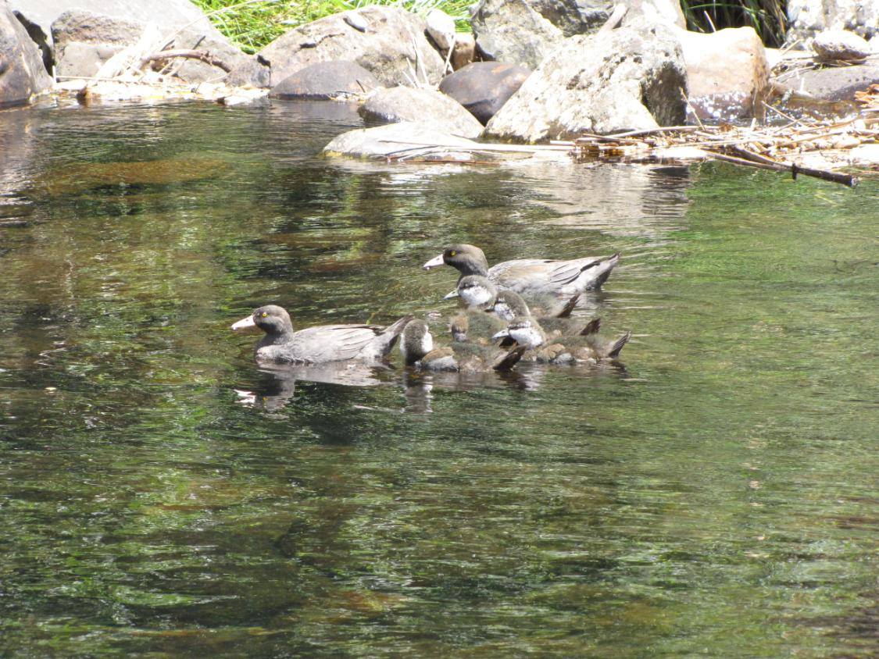
Whio habitats
Which habitats are suitable for whio?
Photo: Bubs Smith

Slide 2
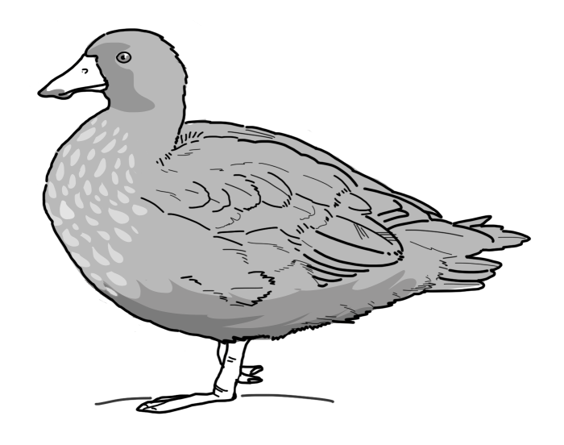
Whio need rivers or streams that are:
fast-flowing
surrounded by trees
rocky-bottomed and clean and clear (not polluted!!)
Can you see any suitable habitats for us?

Slide 3
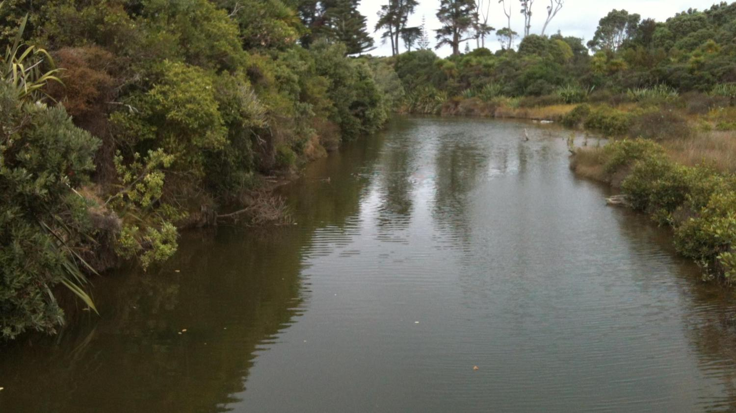
Photo: Shanthie Walker
Notes:
At each slide, ask students: Is this habitat suitable for whio?
This habitat is not suitable for whio- This is a tidal stream near the mouth of a river, leading to the sea. Whio cannot live in salt water habitats. Whio cannot live here. There will be no fresh water and no suitable food for them. There is no fast-flowing water and no rocks.

Slide 4
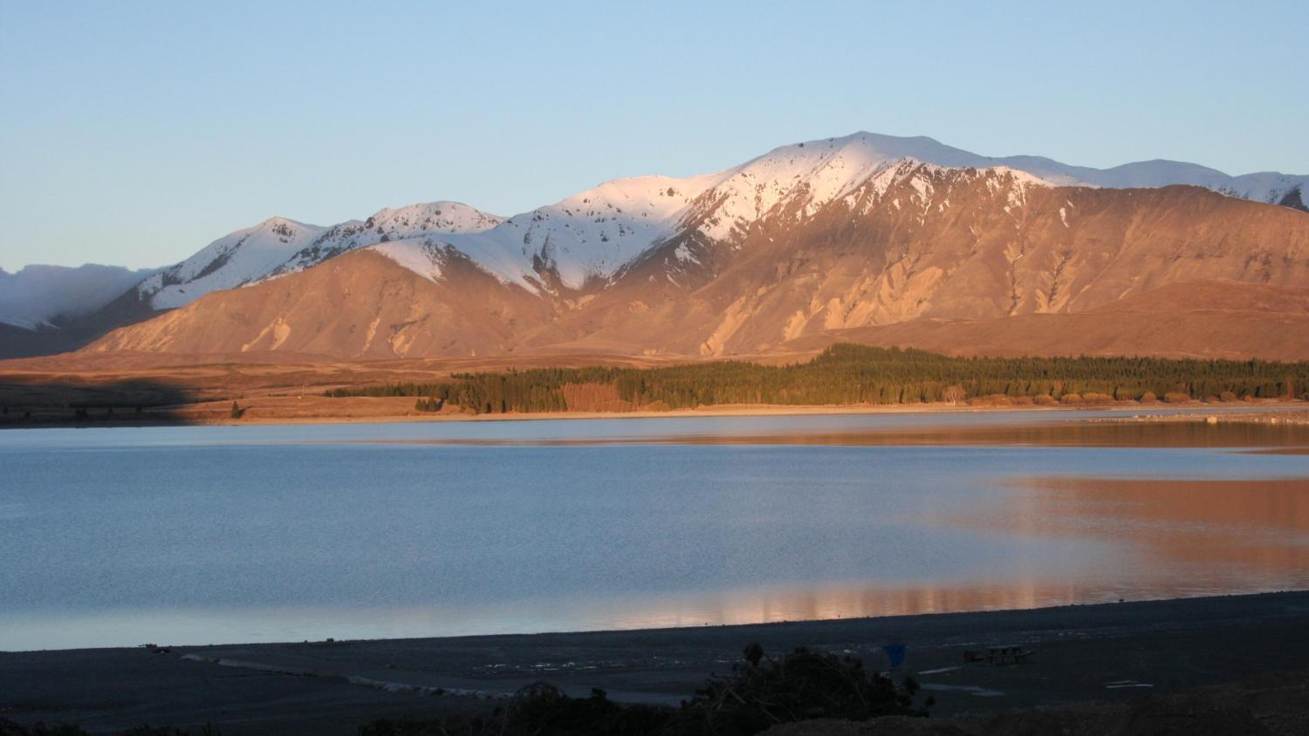
Photo: Shanthie Walker
Notes:
Whio can’t live here. This is Lake Tekapo. The water is not fast-flowing and it is not a river or stream. Although the water here is probably clear and clean, there are few boulders or rocks and not much forest around the stream.

Slide 5
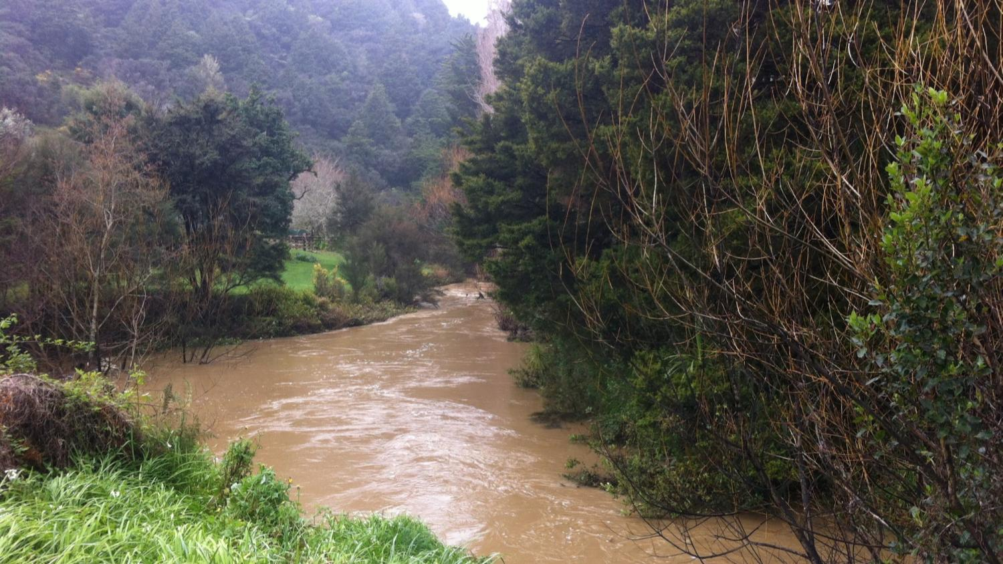
Photo: Shanthie Walker
Notes:
Is this habitat suitable for whio?
No- it does have trees around it and is probably fast- flowing but the water is muddy and full of sediment (brown colour) and not rocky-bottomed. There may also be pollution present.

Slide 6
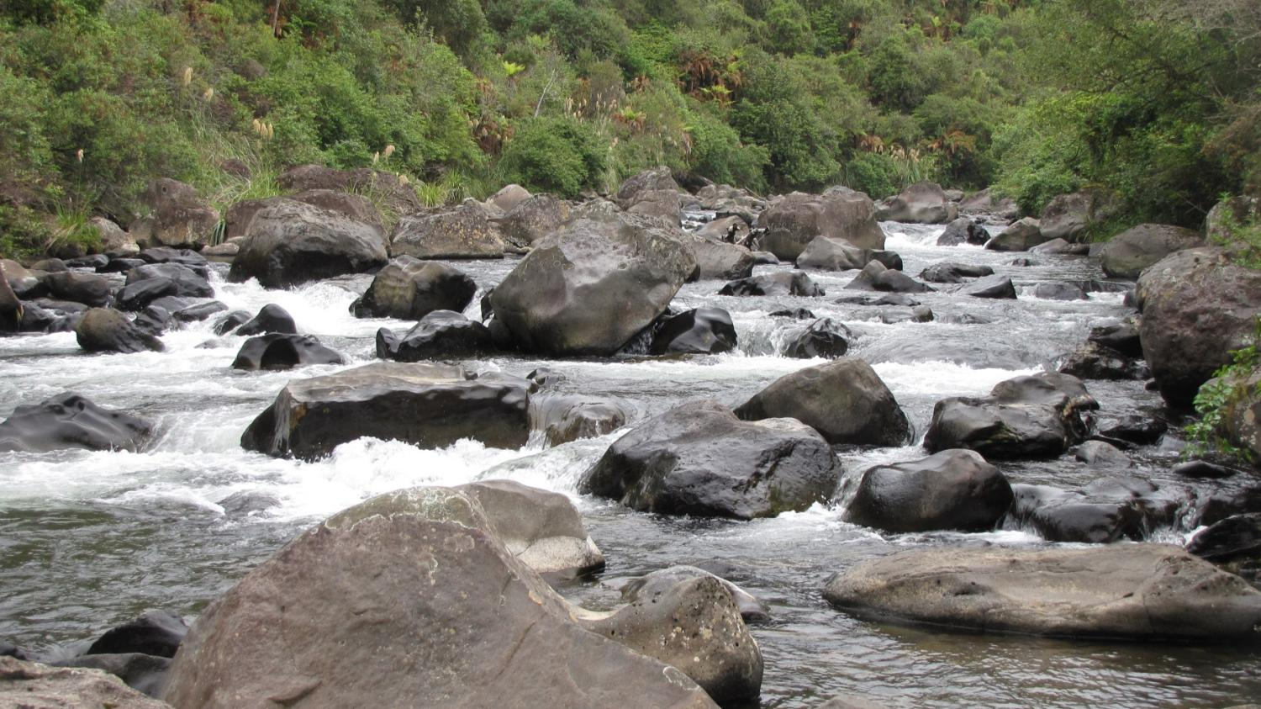
Photo: Bubs Smith
Notes:
YES- This is a fast-flowing, forested stream with a rocky bottom. This is ideal whio habitat.

Slide 7
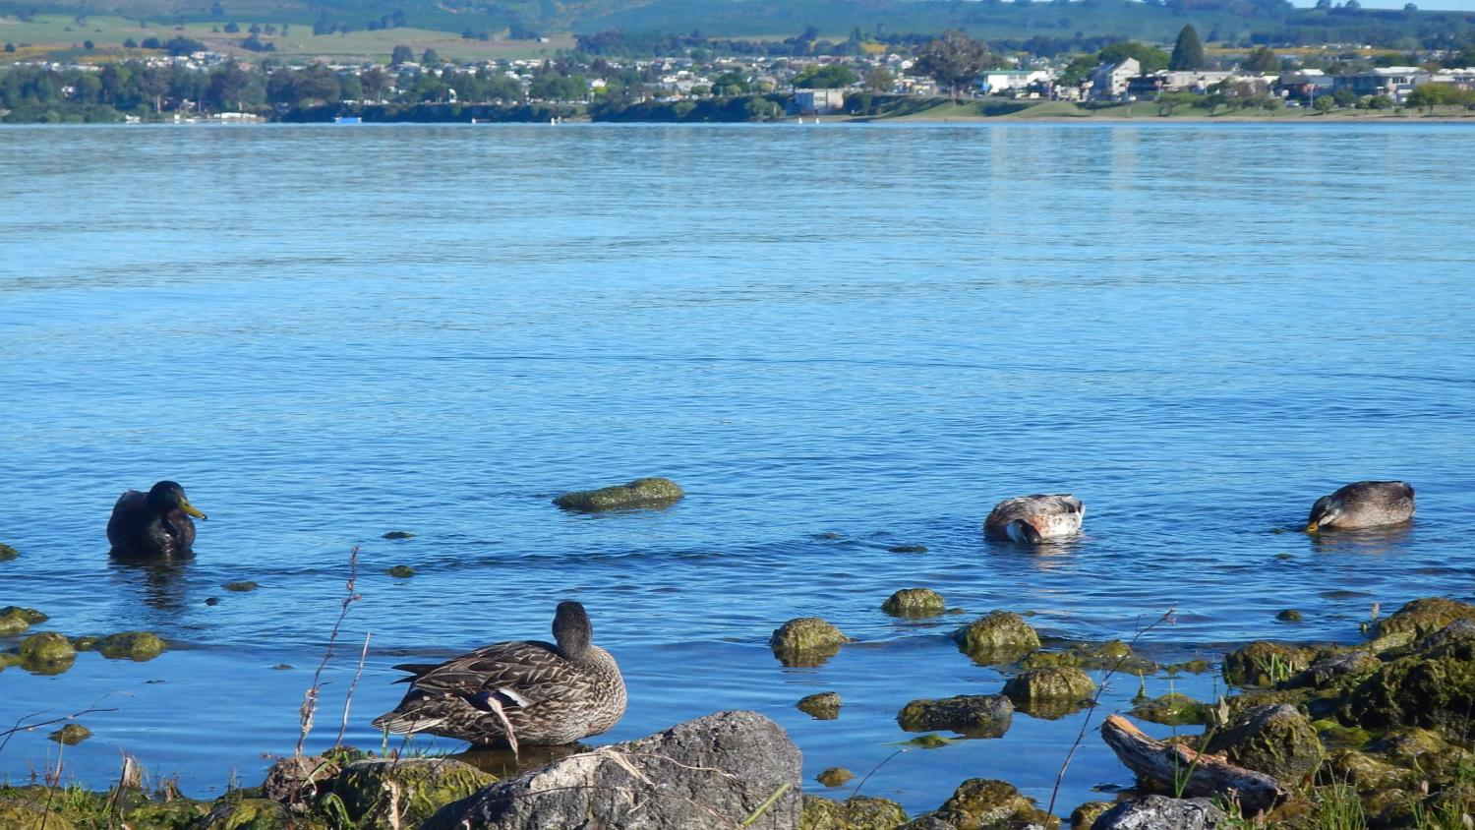
Notes:
Although ducks are living here they are not whio. This habitat is not suitable for whio because there is no fast-flowing water and this is a lake, not a river/ stream environment. There is also a lot of development and human impacts around the lake which would mean it would not be clean and clear enough for whio. (This is Lake Taupō).

Slide 8
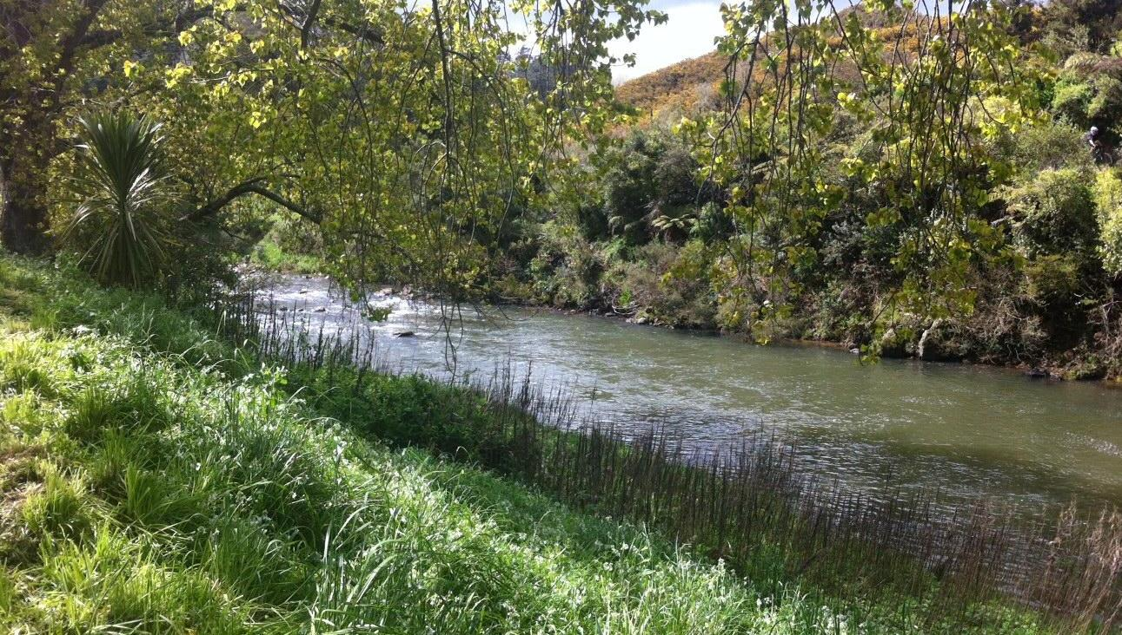
Photo: Shanthie Walker
Notes:
No- Whio won’t live here- there is not enough white water, the water doesn’t look 100% clean and clear, and the trees/ vegetation around the river are not providing enough shade.

Slide 9
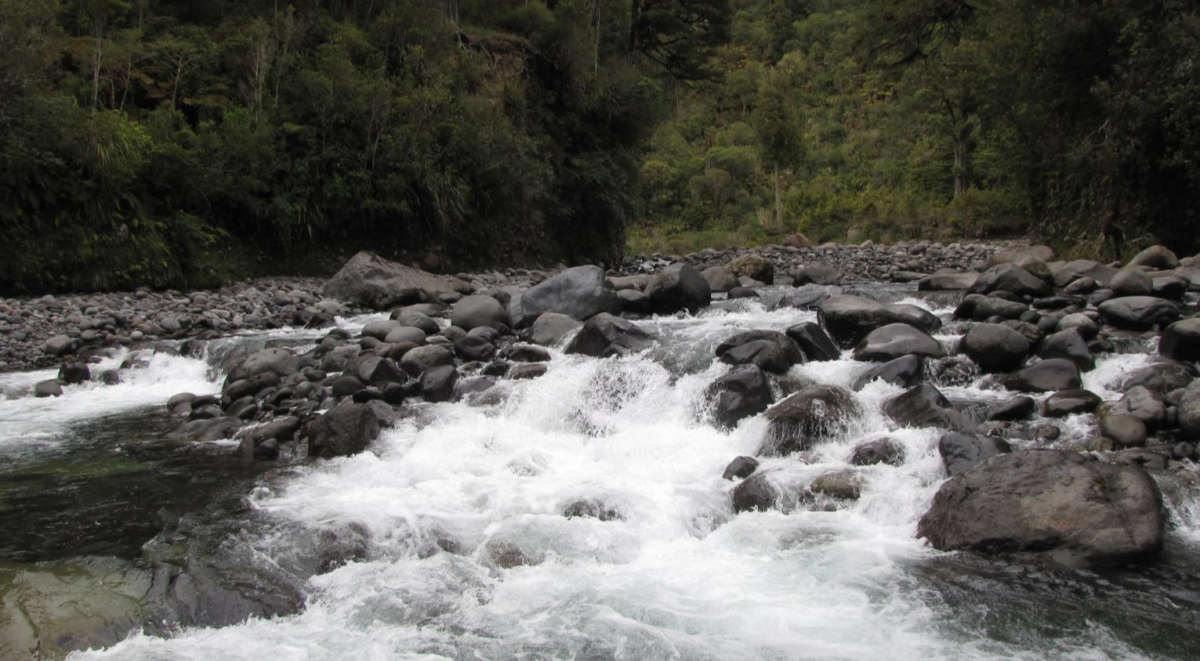
Photo: Bubs Smith
Notes:
YES- This water might look too rough for whio but they are the white water specialists! Whio could live here. This habitat is rocky and lined with trees. The water here is really fast-flowing.

Slide 10
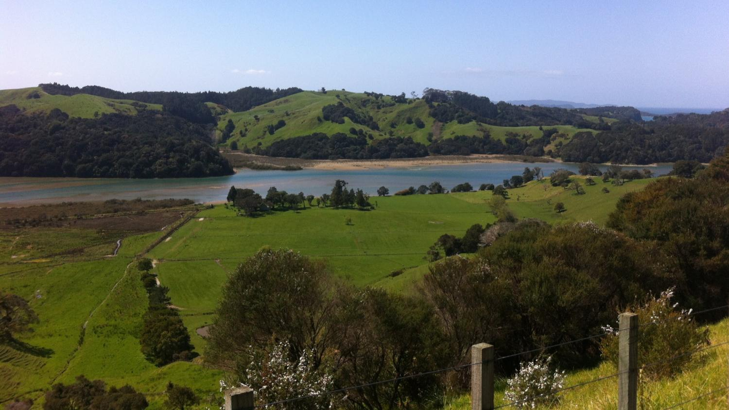
Photo: Shanthie Walker
Notes:
No- This is a salty, tidal river with a muddy/ sandy bottom and slow flow. There are no rocks in the stream. There is little forest around the river and lots of farmland. The water is probably not clean and clear. Whio cannot live here.

Slide 11
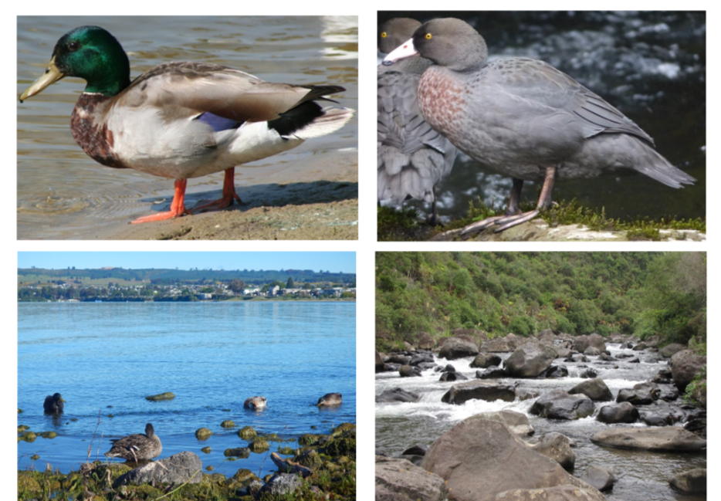
Ducks and their habitats
Mallard duck (on left)
Whio (on right)
What differences can you see between the ducks?
Why would they have these differences?
What do these differences have to do with their habitats?
Photo: Jeff Jones
Photo: Bubs Smith
Photo: Bubs Smith
Notes:
Colour: The mallard is brightly coloured green on the head and grey and brown (this is a male).
The whio is blue-grey in colour with a brown speckled chest.
These colours reflect the habitats they live in for camouflage.
Feet: Mallard: Feet and legs are thick, orange making them strong swimmers. The legs are under the middle of the bird- a feature for dabbling ducks who flip up to feed.
Whio: Feet and legs are thinner and grey-ish. Their legs are set back compared to their bodies which makes them suited to diving
Bodies: Mallard: the body is bulky and rounded, good for buoyancy, not as streamlined as the whio
Whio: the body is sleek and streamlined for minimal resistance in fast flowing water
Bills: Whio bill has rubbery lips on sides for protection when feeding against rocks. Mallard doesn’t need this as they don’t scrape rocks very often with their bills
(These special features are considered more in the following activity)

Slide 12
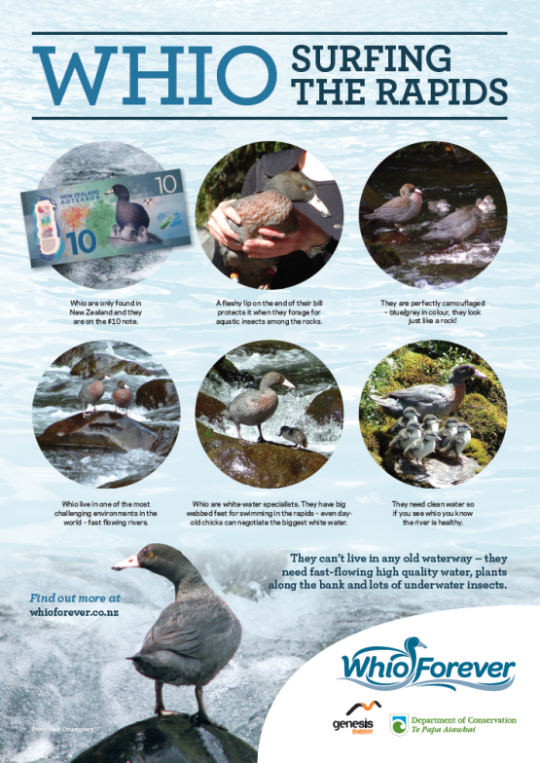
Notes:
Images from Whio surf the rapids poster: http://www.whioforever.co.nz/wp-content/uploads/2016/01/Whio-Surfing-the-Rapids.pdf

